Slide 1
REPRODUCTIVE SYSTEMS

Slide 2
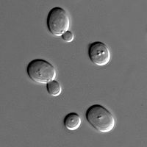
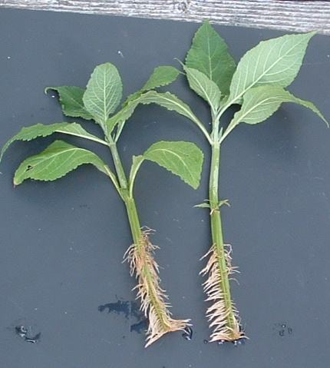
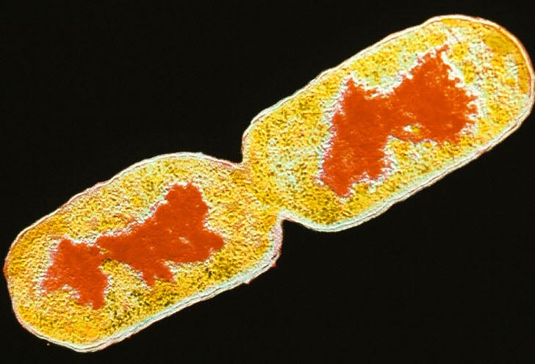
Asexual Reproduction occurs in many kinds of organisms
Budding yeast
Binary fission in bacteria
Rooting plant cuttings
Notes:
Asexual reproduction is the simplest form of reproduction

Slide 3
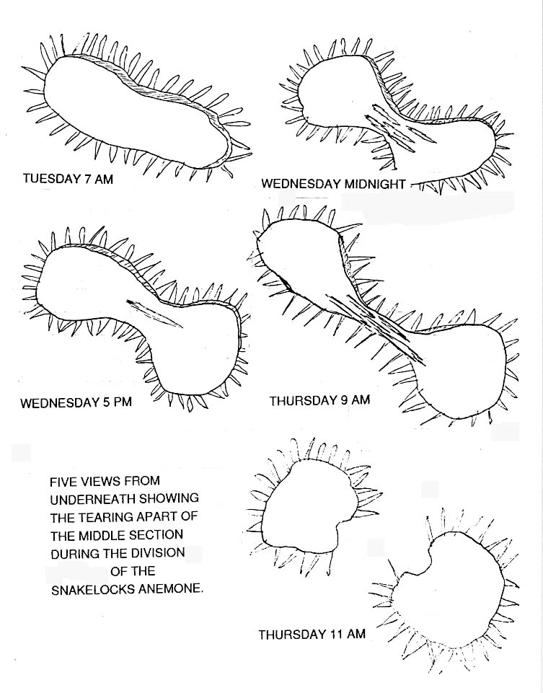
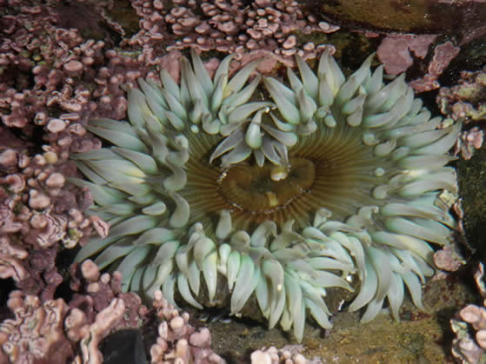
Some animals can reproduce asexually by fission and regeneration

Slide 4
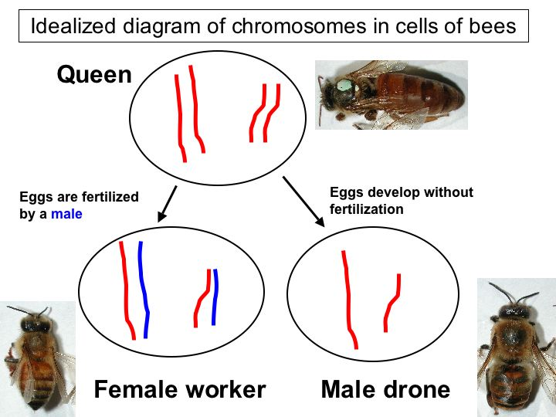
Some animals can reproduce asexually using parthenogenesis (gamete development without fertilization)

Slide 5
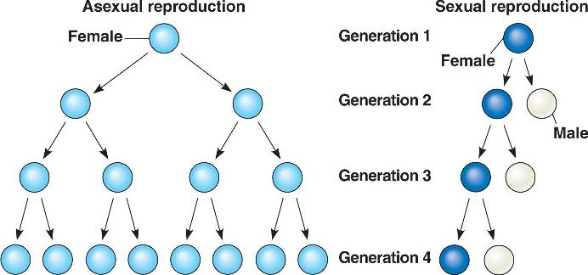
Sexual reproduction comes with an evolutionary cost

Slide 6
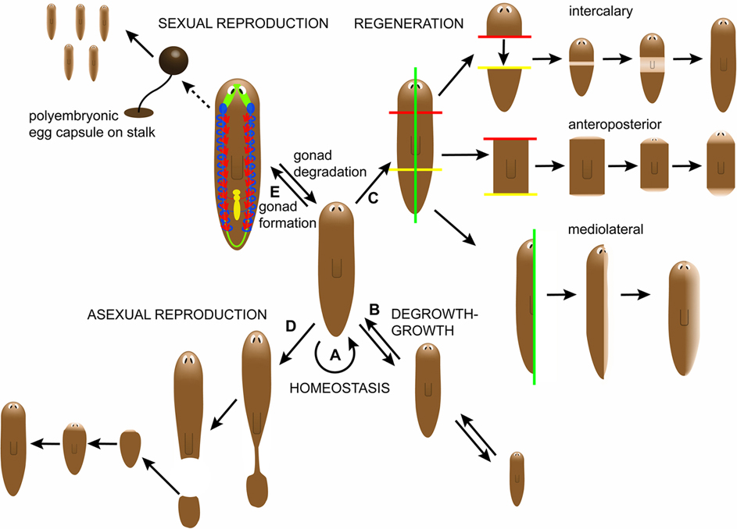
Some animals can switch between sexual and asexual reproduction

Slide 7
Sexual
  Pro
    High genetic diversity in offspring
    Facilitates adaptation
  Con
    Loss of 50% of parental genetics to offspring
    Costs of courtship
Asexual
  Pro
    Parents transmit their full genetics to their offspring
    No need for courtship
  Con
    Lack of genetic diversity
    Limited ability to adapt

Slide 8
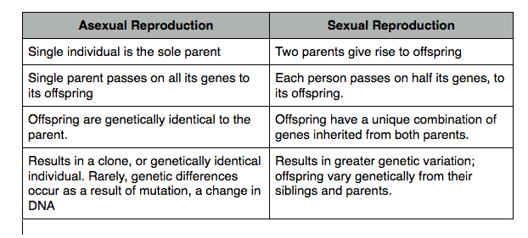

Slide 9
Typically, ‘female’ is defined as the anatomical system associated with producing the larger gametes

Slide 10
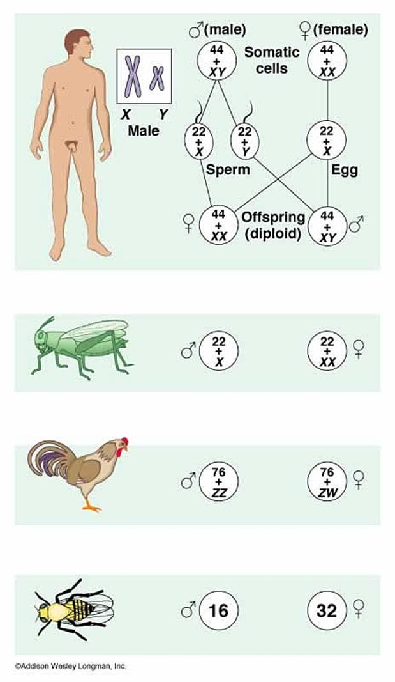
Male and Female are not necessarily associated with a particular pattern of sex chromosomes

Slide 11
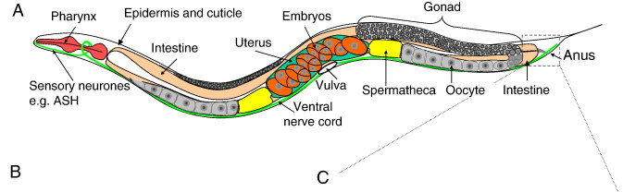
Some animals can produce both male and female gametes: hermaphroditism
The Reproductive System of the nematode C. elegans: As germ cells pass through the bend of the gonad arm (oviduct), the nuclei acquire plasma membrane to form oocytes which enlarge and mature as they move more proximally. They fertilize with the sperm in spermatheca and the zygotes are stored in the uterus and laid outside thorough the vulva which protrudes at the ventral midline
http://www.wormatlas.org/ver1/handbook/anatomyintro/anatomyintro.htm

Slide 12
Human reproductive physiology how do hormones control reproductive function?
Notes:
Hypothalamus sends a signal to the pituitary that causes it to control the primary sex organs (testes and overies) to produce more or less of chemicals which are negatively control their release

Slide 13
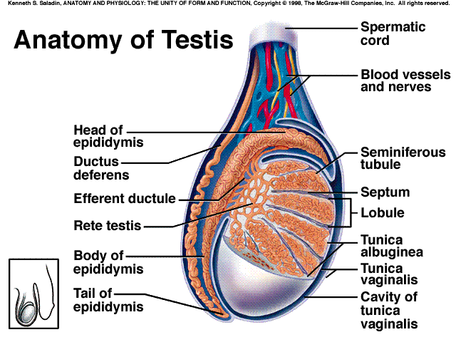
The testes: a) produce sperm b) secrete testosterone

Slide 14
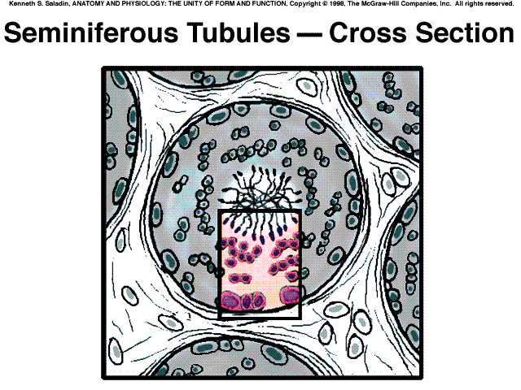


The seminiferous tubules produce sperm
Notes:
The lumen with mature spermatozoa

Slide 15
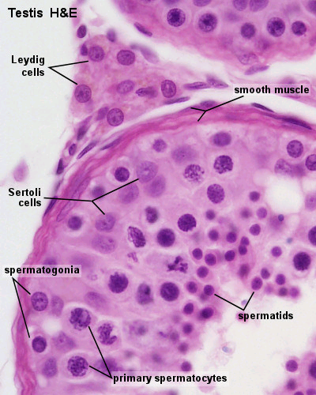
Sperm maturation requires testosterone
Notes:
Leydig cells are also called interstitial cells

Slide 16
Testosterone is concentrated in the testes by androgen binding protein
Notes:
Also called nurse cells
They need to be activated by testosterone, to do this they have androgen binding proteins that concentrate testosterone in the seminary tubules

Slide 17
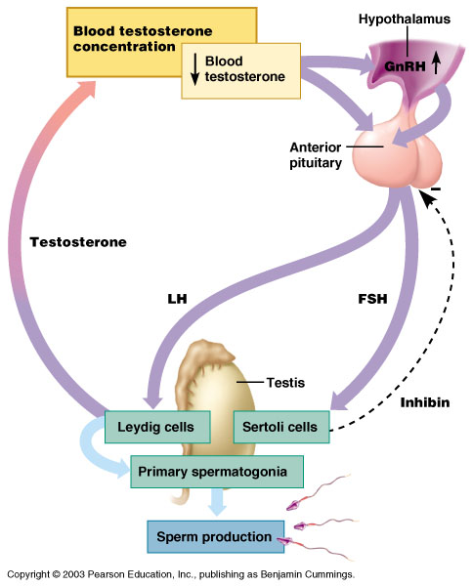
Sperm production is controlled by hormones
Notes:
The system is controlled by the brain (from the hypothalamus to the anterior pituitary gland) through the use of gonadotropins
GnRH: gonadotropin releasing hormone causes the release of gonadotropins
Testosterone is used in a negative feedback loop to slow down the production of testosterone

Slide 18
Testosterone exerts its action via the androgen receptor
The receptor is inside the cell because testosterone can travel into the cell

Slide 19
The female primary sex organs (the ovaries) produce eggs (within follicles) and sex steroids

Slide 20
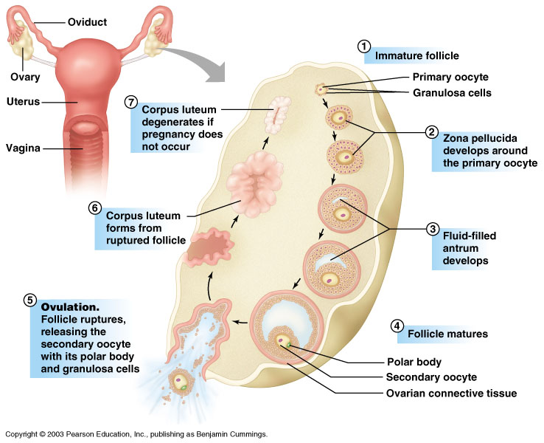
The ovaries are the site where eggs mature within follicles

Slide 21
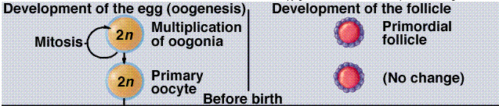
Ovum maturation starts, but does not finish, before birth
A female baby is born with several hundred thousand partially matured ova
Notes:
All the eggs that a female will have are with them even before birth
Ovum maturation starts while a fetus but doesn’t finish until after puberty

Slide 22
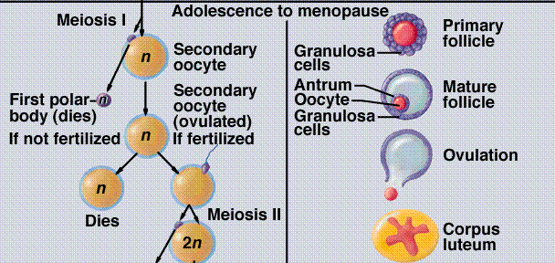
Each cycle after puberty, one (usually) egg and follicle further develop to ovulation
Egg
Follicle
Notes:
The egg is stored in the follicle (red thing in the follicle)
Maturation of the follicle causes the egg to create antrum (a fluid) until the follicle ruptures releasing the egg. The ruptured follicle becomes the corpus luteum

Slide 23
Ovum/follicle development is associated with hormonal changes
GnRH (gonadotropin releasing hormone; hypothalamus) stimulates LH/FSH release
LH (luteinizing hormone; anterior pituitary) stimulates ovulation
FSH (follicle-stimulating hormone; ant. Pit.) stimulates follicle maturation
Estrogen (follicle) stimulates uterine development
Progesterone (corpus luteum) stimulates uterine maturation
Notes:
LH is the trigger for ovulation
LH and FSH go up and down in concentration together
estrogen is produced throughout the cycle, while progesterone is only produced to mature the uterus

Slide 24
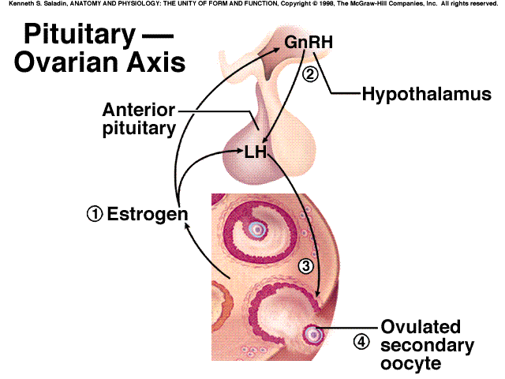
Notes:
Estrogen comes from the follicle

Slide 25
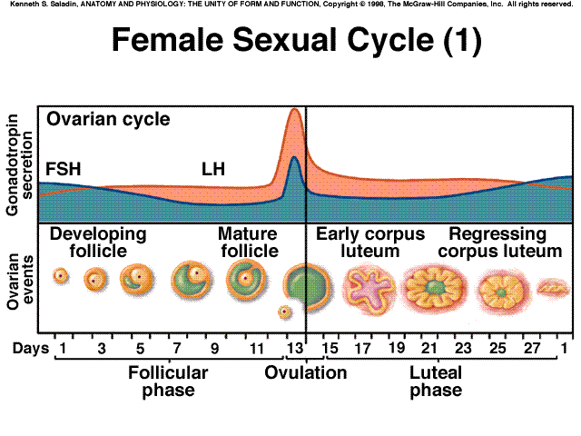
LH and FSH levels cycle with the changes in the follicle
Notes:
The phases are determined by the follicle, before ovulation is when the follicle is developing
Peak in LH is called the “LH surge”

Slide 26
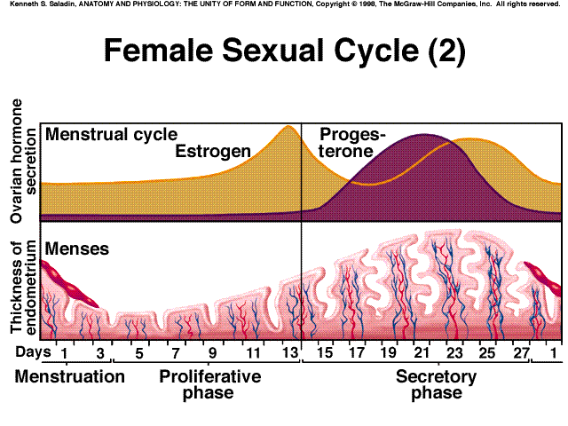
Estrogen and progesterone cycle along with changes in the uterus
Notes:
Extrogen is produced even before ovulation, this is what causes the LH surge
When steroid levels drop, the uterus lining begins to shed

Slide 27
Cycle length
The menstrual phase lasts a few days
The follicular phase is of variable length
The luteal phase is about 2 weeks long; menstruation occurs about 2 weeks after ovulation
Notes:
The cycle is typically 28 days long but not always

Slide 28
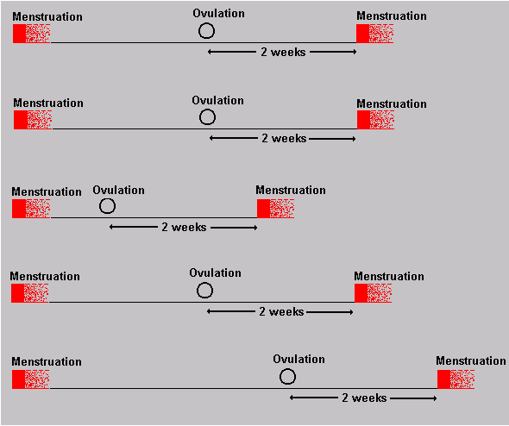
Notes:
Menstruation always happens 2 weeks after ovulation but ovulation can occur at varying # of days after menstration

Slide 29
Fertility: when can a woman become pregnant?
The egg lives for about 24 hrs after ovulation
The sperm can live for up to about 72 hrs inside the woman
Therefore, a woman is fertile (impregnable) from about 3 days before ovulation until about 1 day after

Slide 30
Useful videos
https://www.youtube.com/watch?v=-XQcnO4iX_U until about 5 minutes
https://www.youtube.com/watch?v=RFDatCchpus

